Slide 1
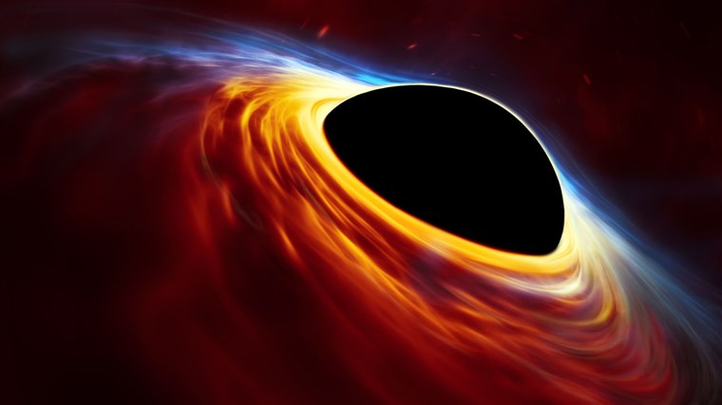
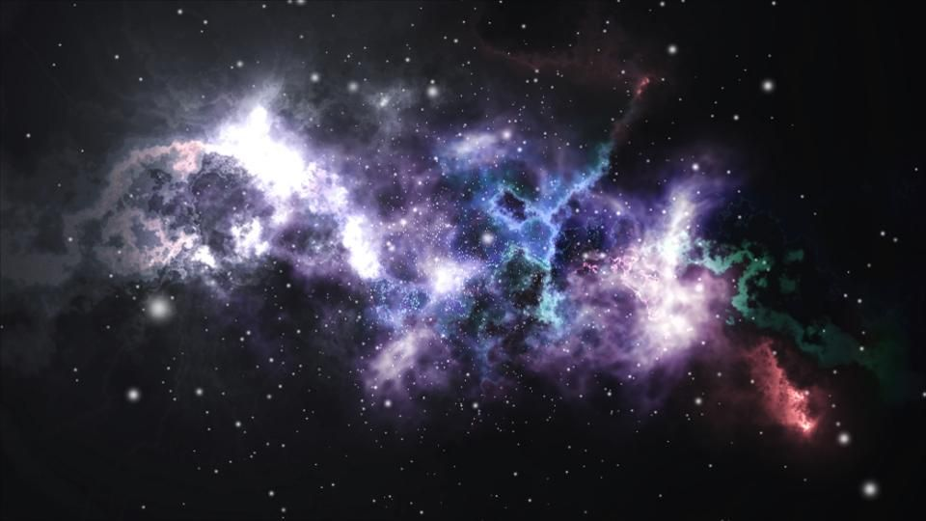
General Relativity: The Secrets of Acoustic Black Holes
(1)
Abhay Katyal

Slide 2
Introduction to Special and General Relativity

Slide 3
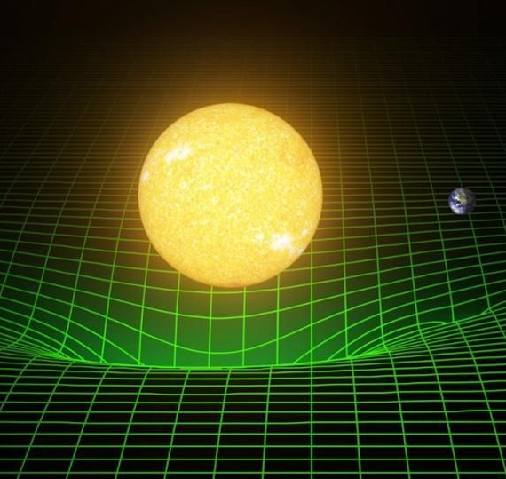
Gravity and Spacetime
(2)
Many forces are described as fields on spacetime, but Gravity IS spacetime!
Special Relativity: space and time are not absolute
Notes:
1st bullet
Massive objects curve spacetime to create attractive force
2D sheet warping example
2nd bullet
Two observers in different reference frames can measure the same event and measure different distances and time, which is due to length contraction and time dilation

Slide 4
The Spacetime Interval : Δs
If space is different for your frame of reference, how do you measure distances?
Normal distance in n-dimensional Euclidean space:
$$Δs^{2}=\{Δx^{2}+Δy^{2}+⋯\} n−terms$$
The Spacetime Interval is invariant in all frames (assuming no gravity):
$$Δs^{2}=−(cΔ{t)}^{2}+Δx^{2}+Δy^{2}+Δz^{2}$$
(Assume c = 1 for simplicity from now on)
Notes:
- 1st slide
Normal convention of distance = Pythagorean theorem
2nd
3rd
- Notice: multiplying by c gives the units of distance. Now, time becomes one of our dimensions
- 3rd - Spacetime interval as measured by observers is invariant

Slide 5
Minkowski space and the Metric Tensor
Minkowski space Flat spacetime (no curvature) no gravity
Special Relativity cares about 3 coord. of space and 1 coord. of time to construct a space-time 4 vector:
$$x^{μ}=\left[\begin{matrix}t \\ x \\ y \\ z\end{matrix}\right]$$
We can define a matrix with the same components. This is the Minkowski metric tensor:
$t x y z$
$$η_{uv}=\left[\begin{matrix}−1 & 0 & 0 & 0 \\ 0 & 1 & 0 & 0 \\ 0 & 0 & 1 & 0 \\ 0 & 0 & 0 & 1\end{matrix}\right]$$
Notes:
-1st
-2nd – spacetime 4 vector
-3rd
Metric tensor describes the curvature/geometry of spacetime.
Do not say: metric tensor is type (0,2) tensor
Be able to explain tensor transformation law if asked: Tensor is a matrix that transforms in a specific manner.

Slide 6
The Metric Tensor
$ⅆs^{2}=\sum_{μ,v=0}^{3}{η_{μv}}dx^{μ}ⅆx^{v}=\left[dt dx dy dz\right]\left[ \begin{matrix}−1 & 0 & 0 & 0 \\ 0 & 1 & 0 & 0 \\ 0 & 0 & 1 & 0 \\ 0 & 0 & 0 & 1\end{matrix}\right] \left[\begin{matrix}dt \\ ⅆx \\ dy \\ ⅆz\end{matrix}\right]$
$=−ⅆt^{2}+ⅆx^{2}+ⅆy^{2}+ⅆz^{2}$
$=ⅆs^{2}$ [1]
The metric tensor varies with local curvature, ex. a black hole.
The spacetime interval will have different coefficients in different curved spaces
Notes:
- 1st Go thru calculation of ds^2
- 2nd Remember, metric tensor describes the geometry of spacetime, so it changes with local curvature
- 3rd Our form of the spacetime interval changes in GR. Spacetime interval will have different coefficients in curved space, which might not be constants

Slide 7
Black Holes

Slide 8
Metric of a Stationary Black Hole
Metric in Schwarzschild coordinates, makes it easier to see the event horizon
We should see the metric approximate the spherical Minkowski metric in the limit of the distance approaching infinity.
$g_{μv}=\left(\begin{matrix}\begin{matrix}−\left(1−\frac{2GM}{r}\right) \\ 0 \\ 0 \\ 0\end{matrix} & \begin{matrix}0 \\ {\left(1−\frac{2GM}{r}\right)}^{−1} \\ \\ 0 \\ 0\end{matrix} & \begin{matrix}0 \\ 0 \\ r^{2} \\ 0\end{matrix} & \begin{matrix}0 \\ 0 \\ 0 \\ r^{2}{sin⁡}^{2}(θ)\end{matrix}\end{matrix}\right)$ →
$ⅆs^{2}=−\left(1−\frac{2GM}{r}\right){dt}^{2}+{\left(\begin{matrix} \\ 1−\frac{2GM}{r}\end{matrix}\right)}^{−1}{dr}^{2}+r^{2}ⅆΩ^{2}$
Notes:
1st
2nd
spherical coordinates because of spherical symmetry
- r = infinity and r = 2GM/c^2
- By the way, the Schwarzschild metric describes one of the very few exact solutions to the Einstein field equations

Slide 9
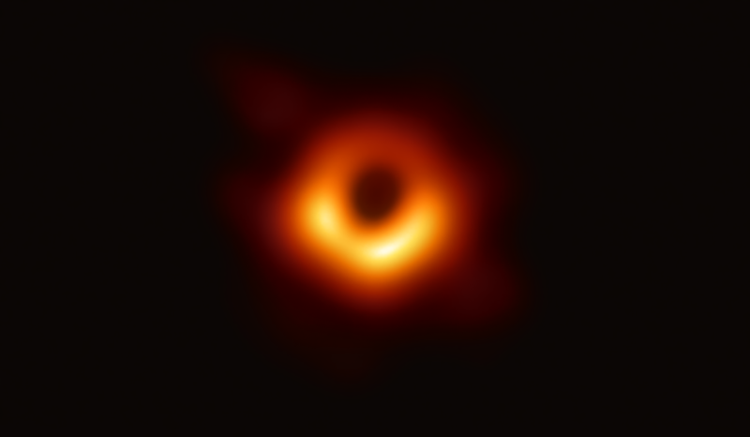
Features of Black Holes
(3)

Slide 10
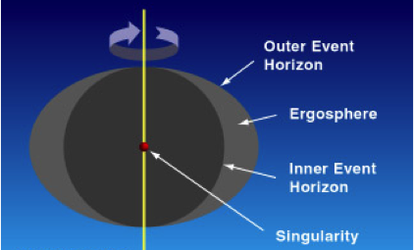
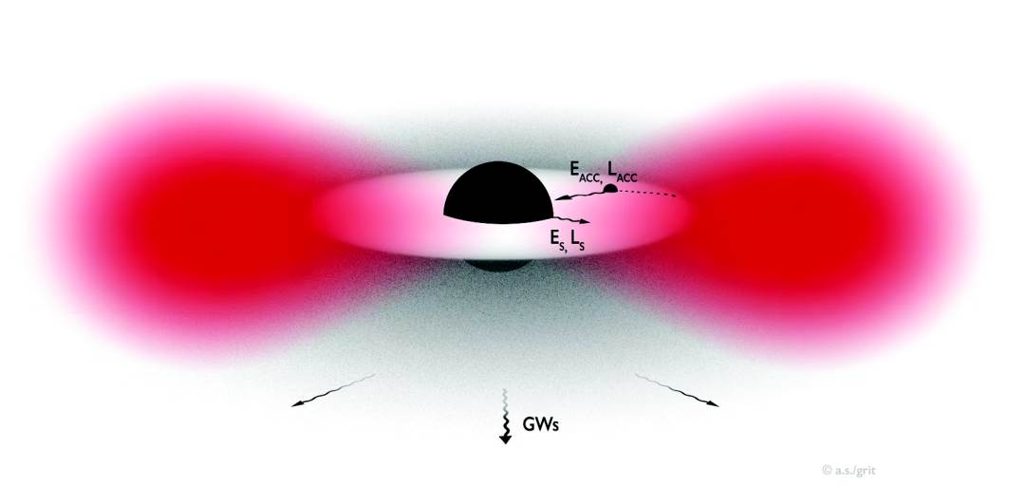
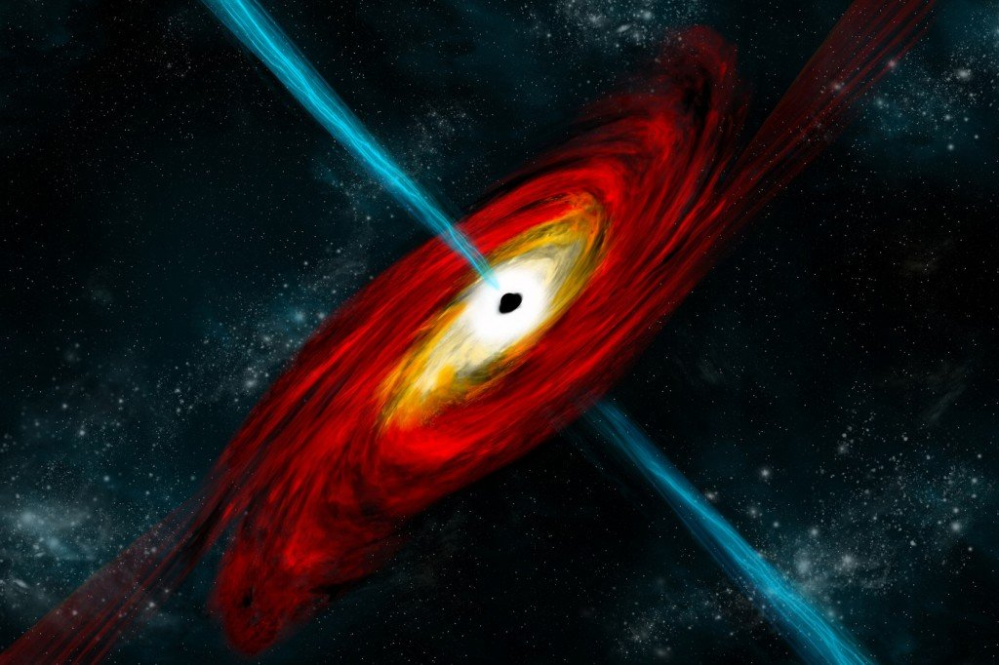
Features of Black Holes
Ergosphere
Superradiance
Hawking radiation
Event Horizon
(6)
(Only for rotating black holes)
(5)
(Only for rotating black holes)
(4)
Notes:
Event horizon – boundary where escape velocity exceeds the speed of light; aka nothing can escape back once beyond this boundary
Hawking radiation – black-body radiation emitted by black holes, causing them to slowly lose energy in time.
Superradiance & Ergosphere only exist for rotating black holes.

Slide 11
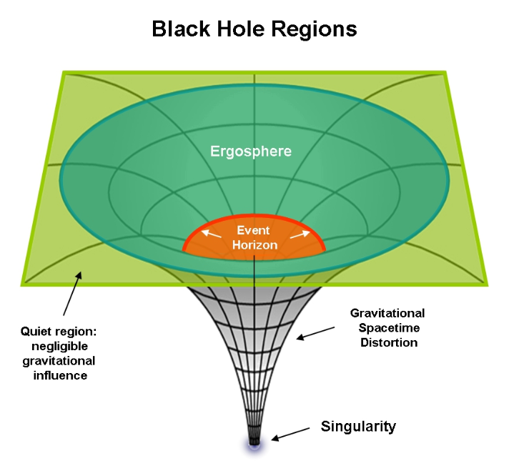
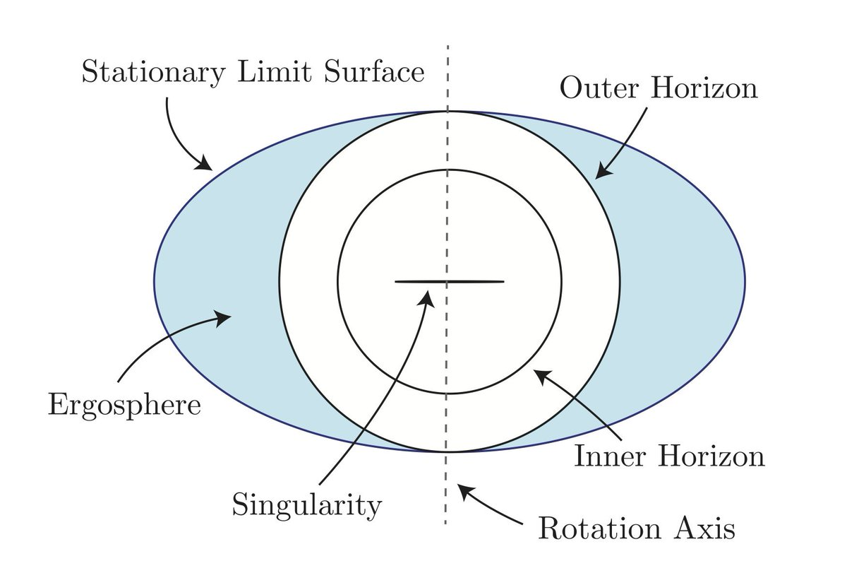
](7)
(8)
Notes:
Superradiance (for rotating black holes) – emitted radiation come back amplified by stealing angular momentum from black hole
Ergosphere (for rotating black holes) –region where objects cannot be stationary anymore. Rotating bodies co-rotate with their curvature of spacetime; in other words, the rotating bodies drag spacetime itself along with them as they rotate.

Slide 12
The Information Paradox
Hawking Radiation gives rise to a question about information conservation
Properties such as spin of particles are lost once particles converge with Black Hole
Measurement of a temperature of Hawking Radiation confirms that Information is not conserved
Notes:
-1st slide
Suppose you have a chain of quantum particles with different spins. You could read off their spin as binary info if you wanted. But all that information is lost once particles converge with black hole.
If a temperature is present, information is not conserved.

Slide 13
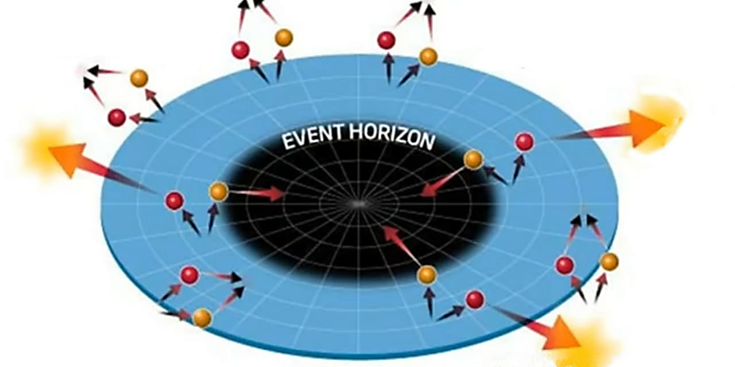
(9)
Notes:
- Virtual particles come into existence. At event horizon. If pair particles radiate outwards, and they reach thermal eq with the surrounding particles, they can possibly contain any information about the particles inside. And the presence of thermal eq implies a temp must exist.

Slide 14
Acoustic Black Holes

Slide 15
What is an Acoustic Black Hole?
They aren’t black holes at all!
However, they work eerily with the same physics mechanisms
Fluid supercooled down to make local speed of sound slower than medium [2]
Analogous systems to rotating black holes; use sound waves instead of light
Notes:
1st and 2nd
Quantum super cooled to Bose-Einstein Condensate. Explain local speed of sound
4th

Slide 16
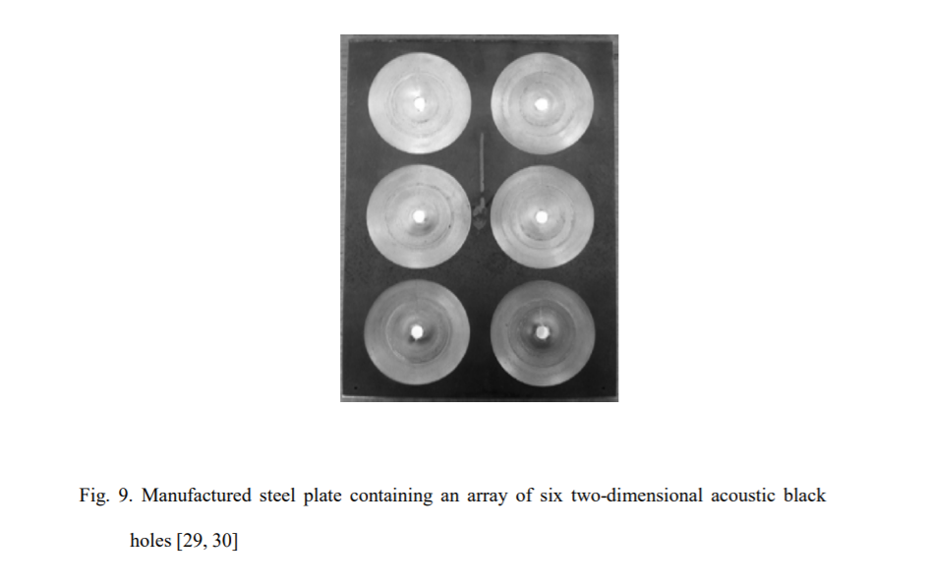
[3]
Notes:
- Fluid spinning in a funnel shape

Slide 17
Equations of the Acoustic Black Hole
Continuity Eq for fluid flow
Euler's eq for fluid flow
$$∂_{t}ρ+∇⋅\left(pv\right)=0$$
$$ρ\frac{ⅆv}{ⅆt}≡ρ \left[∂_{t}v+\left(v⋅∇\right)v\right]=F$$
[4]
Notes:
Using these 2 eqs, we can derive all our equations that describe how these acoustic black hole systems function. Which is weird, but cool… these equation come from fluid flow, have nothing to do with gravity, but the similarities are undeniable.

Slide 18
The Acoustic Metric
The acoustic metric:
Space-time interval:
$$g_{μv}≡ \frac{ρ_{0}}{c} \left[\begin{aligned} \begin{matrix}\begin{aligned}−(c^{2}−v_{0}^{2}) \\ ⋯⋯⋯⋯\end{aligned} & \begin{aligned}−v_{0}^{j} \\ ⋯⋯⋯\end{aligned} \\ −v_{0}^{i} & δ_{ij}\end{matrix} \\ \end{aligned}\right]$$
$$⋮$$
$$⋱$$
$$⋮$$
$$ⅆs^{2}≡g_{uv}{dx}^{μ}ⅆx^{v}=\frac{ρ_{0} }{c}\left[ −c^{2}ⅆt^{2}+\left(ⅆx^{ⅈ}−v_{0}^{i}ⅆt\right) δ_{ij}\left(ⅆx^{j}−v_{0}^{j}ⅆt\right) \right]$$
Notes:
Analogous to metric of rotating black holes
The metric here defines how the fluid moves on its defined geometry

Slide 19
Analogous properties of acoustic and rotating black hole
1
4 velocity vector
2
Phonons = quantum units of sound
3
Event horizon
4
Superradiance
5
Ergosphere because it rotates

Slide 20
Analogous Hawking Radiation
Radiation consists of phonons
Temperature of radiation via superradiance between two acoustic black holes measured at $T= {3.5×10}^{−10}K$[5]
This result confirms our theoretical prediction with acoustic black hole theory:
$$kT_{H}=\frac{{\overline{h}g}_{h}}{2πc}$$
$$T_{H}=(1.2×{10}^{−9}Km)\left[\frac{c}{1000ms^{−1}}\right]\left[\frac{1}{c} \frac{∂\left(c−v_{⊥}\right)}{∂n}\right]$$
Notes:
Acoustic hawking radiation made from phonons
Used superradiance to amplify temp signal

Slide 21
Implications about Information in Black Holes
If two systems are analogous all the way, the temperature result implies that information is not conserved in a black hole
Major problem in physics, acoustic black holes could help us clarify this result
Notes:
We know the acoustic and rotating black hole have an incredible amount of parallels, so assuming we can extend this analogy all the way: the measurement of a temperature in an acoustic system implies RBH will also have a temperature.
Information is not conserved along a black hole
This would be a much better solution than trying to get closer to the event horizon and measure the temperature!

Slide 22
Acoustic Black Holes in a Nutshell
They help us study arguably the most mysterious objects in our Universe (without creating a black hole to destroy the Earth ☺ )

Slide 23
Acknowledgements
Thank you to the entire DRP team for this entire semester and the constant communication during this transition!
Huge thanks to my mentor Vikas! He’s awesome, and he helped me learn so much more over the course of this semester than I ever thought I would.

Slide 24
Citations
[1] S.M. Carroll, Spacetime and Geometry: an Introduction to General Relativity (Cambridge University Press, Cambridge, United Kingdom, 2019).
[2] Sakalli, I., Övgün, A., Jusufi, K., 2016. GUP assisted Hawking radiation of rotating acoustic black holes. Astrophysics and Space Science.. doi:10.1007/s10509-016-2922-x
[3] KRYLOV, V.V., 2014. Acoustic black holes: recent developments in the theory and applications. IEEE Transactions on Ultrasonics, Ferroelectrics and Frequency Control, 61 (8), pp.1296-1306.
[4] Visser, M., 1998. Acoustic black holes: horizons, ergospheres and Hawking radiation. Classical and Quantum Gravity.. doi:10.1088/0264-9381/15/6/024
[5] Muñoz de Nova, J.R., Golubkov, K., Kolobov, V.I. et al. Observation of thermal Hawking radiation and its temperature in an analogue black hole. Nature 569, 688–691 (2019). https://doi.org/10.1038/s41586-019-1241-0

Slide 25
Citations for images
(1) https://www.forbes.com/sites/servicenow/2020/04/10/fighting-covid-19-one-app-at-a-time/#78d2ac8841be
(2) https://medium.com/starts-with-a-bang/ask-ethan-if-mass-curves-spacetime-how-does-it-un-curve-again-ce51a391cdc4
(3) https://www.nytimes.com/2020/05/06/science/black-hole-intermediate.html
(4) https://www.scienceabc.com/nature/universe/neutron-stars-black-holes-born-dying-star.html
(5) https://cqgplus.com/2015/06/11/black-hole-superradiance-and-the-hunt-for-dark-matter/
(6) http://thehallwayherald.weebly.com/black-holes
(7) http://www.astronomysource.com/tag/what-is-an-ergosphere/
(8) https://twitter.com/mcnees/status/996868982278971394
(9) https://www.spaceduniya.in/2019/09/what-is-hawking-radiation-full-info.html

